Slide 1

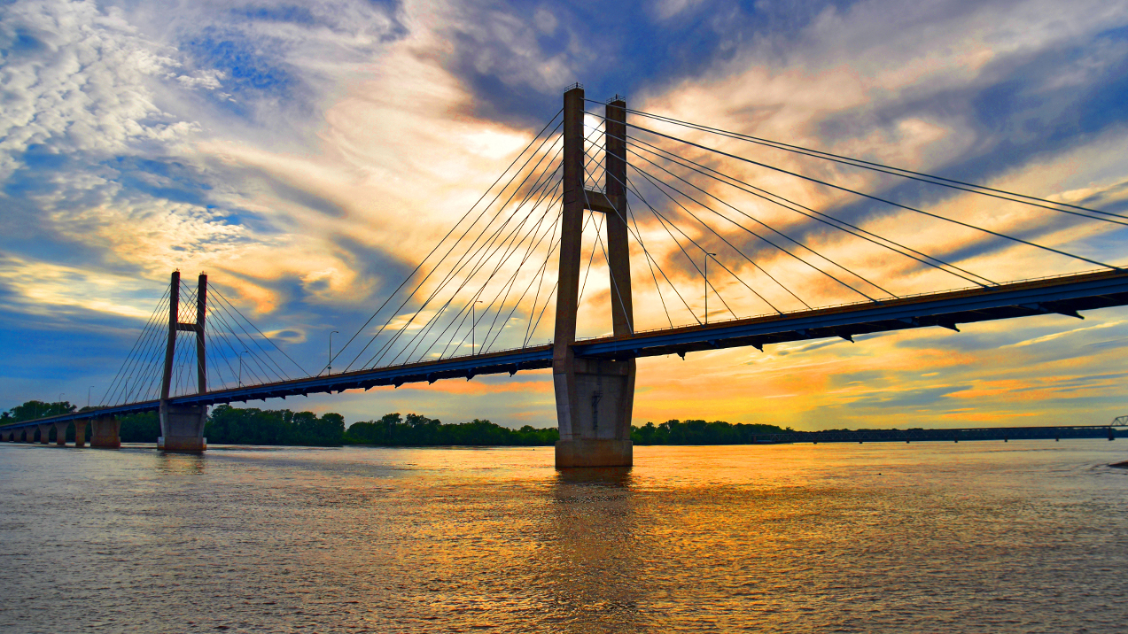

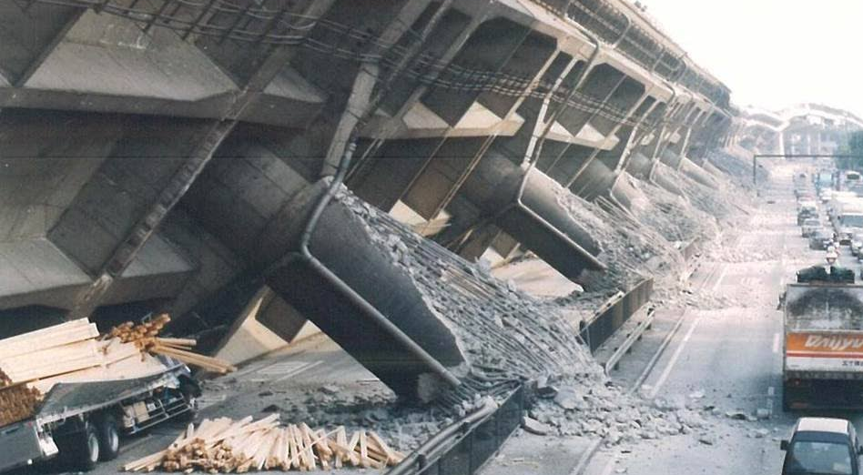
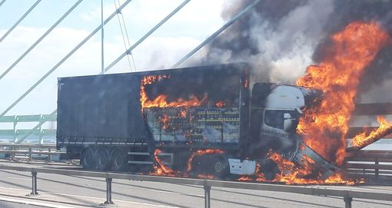
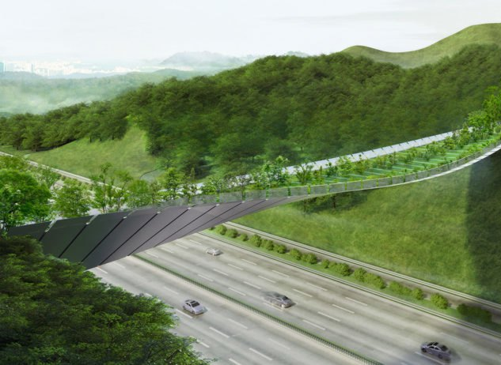
About me
Name: Andrea Franchini
Position: PhD Student
Project: Multi-hazard Structural Optimisation of Bridges
Main aim: to advance the multihazard design optimisation practice for bridges in earthquake-prone areas, considering the competing demands introduced by fire safety and sustainability goals.
Objectives:
Advance the bridge design optimisation practice in the two single-hazard scenarios of earthquake and fire
Investigate synergies and trade-offs in designing bridges for seismic safety, fire safety and sustainability
Develop multi-hazard optimisation approaches for bridges subject to earthquake and fire, including sustainability objectives
Notes:
Introduction about the key characteristics of csb
Describe the key tool of procedure, pff
Show its application to optimize a case study bridge.

Slide 2











Results so far
Experimental design and structural analysis
Probabilistic optimisation
Surrogate modelling
Parameterised fragility
$$EC:optimal/initial$$
$$Meadian IM:optimal/initial$$
$$x[m]$$
Hazard
Structure
Risk
$$x[m]$$
Fire
$$Time$$
Structure
Risk
$$H$$
Notes:
Introduction about the key characteristics of csb
Describe the key tool of procedure, pff
Show its application to optimize a case study bridge.

Slide 3


About me
Notes:
Introduction about the key characteristics of csb
Describe the key tool of procedure, pff
Show its application to optimize a case study bridge.

